Slide 1
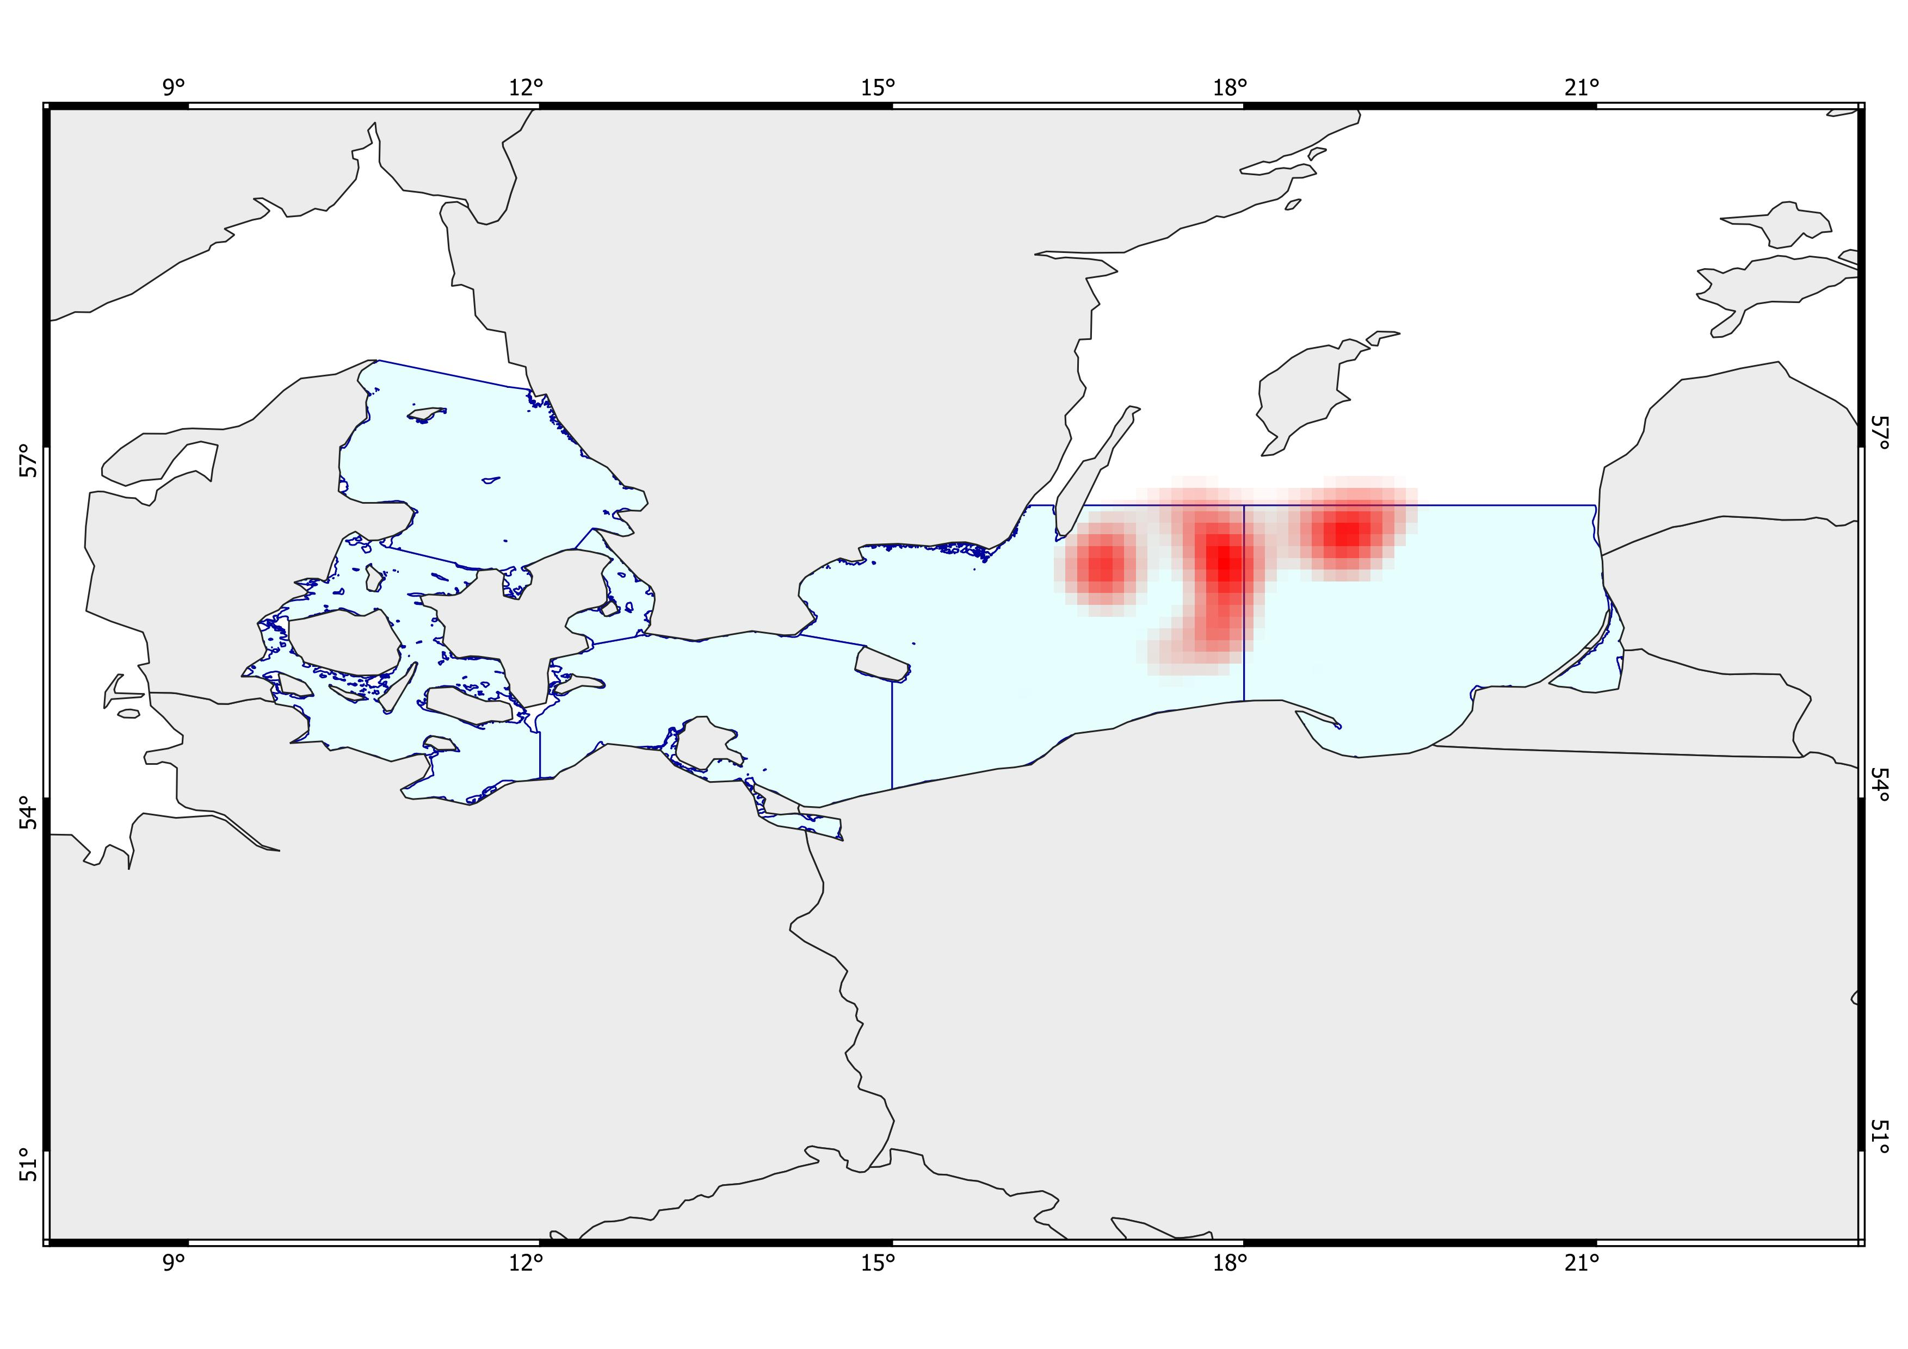
Moderately deep, cold areas with fair bottom oxygen, low salinity, and fair surface productivity. Very high biomass. Low fishing activity, and high shipping traffic. Presence of dumping sites and wind farms.
Deep, cold areas with low bottom oxygen, low bottom salinity, and low surface productivity. Very high biomass. Moderate fishing activity, and fair to moderate shipping traffic. Presence of wind farms and dumping sites.
Very deep, cold areas with moderately low bottom oxygen and moderate bottom salinity, and very low surface productivity. Very high biomass. Fair fishing activity and moderate shipping traffic. Moderate to high anthropogenic influence, with dumping sites and wind farms, and minimal presence of military areas.
Deep, fairly cold areas with extremely low bottom oxygen and moderate surface productivity. Very high biomass, moderate salinity, high fishing activity, moderate shipping traffic, and minimal presence of wind farms.
3
1
2
4
Ecosystem Risk Assessment
Multi K-means
- All species -

Slide 2
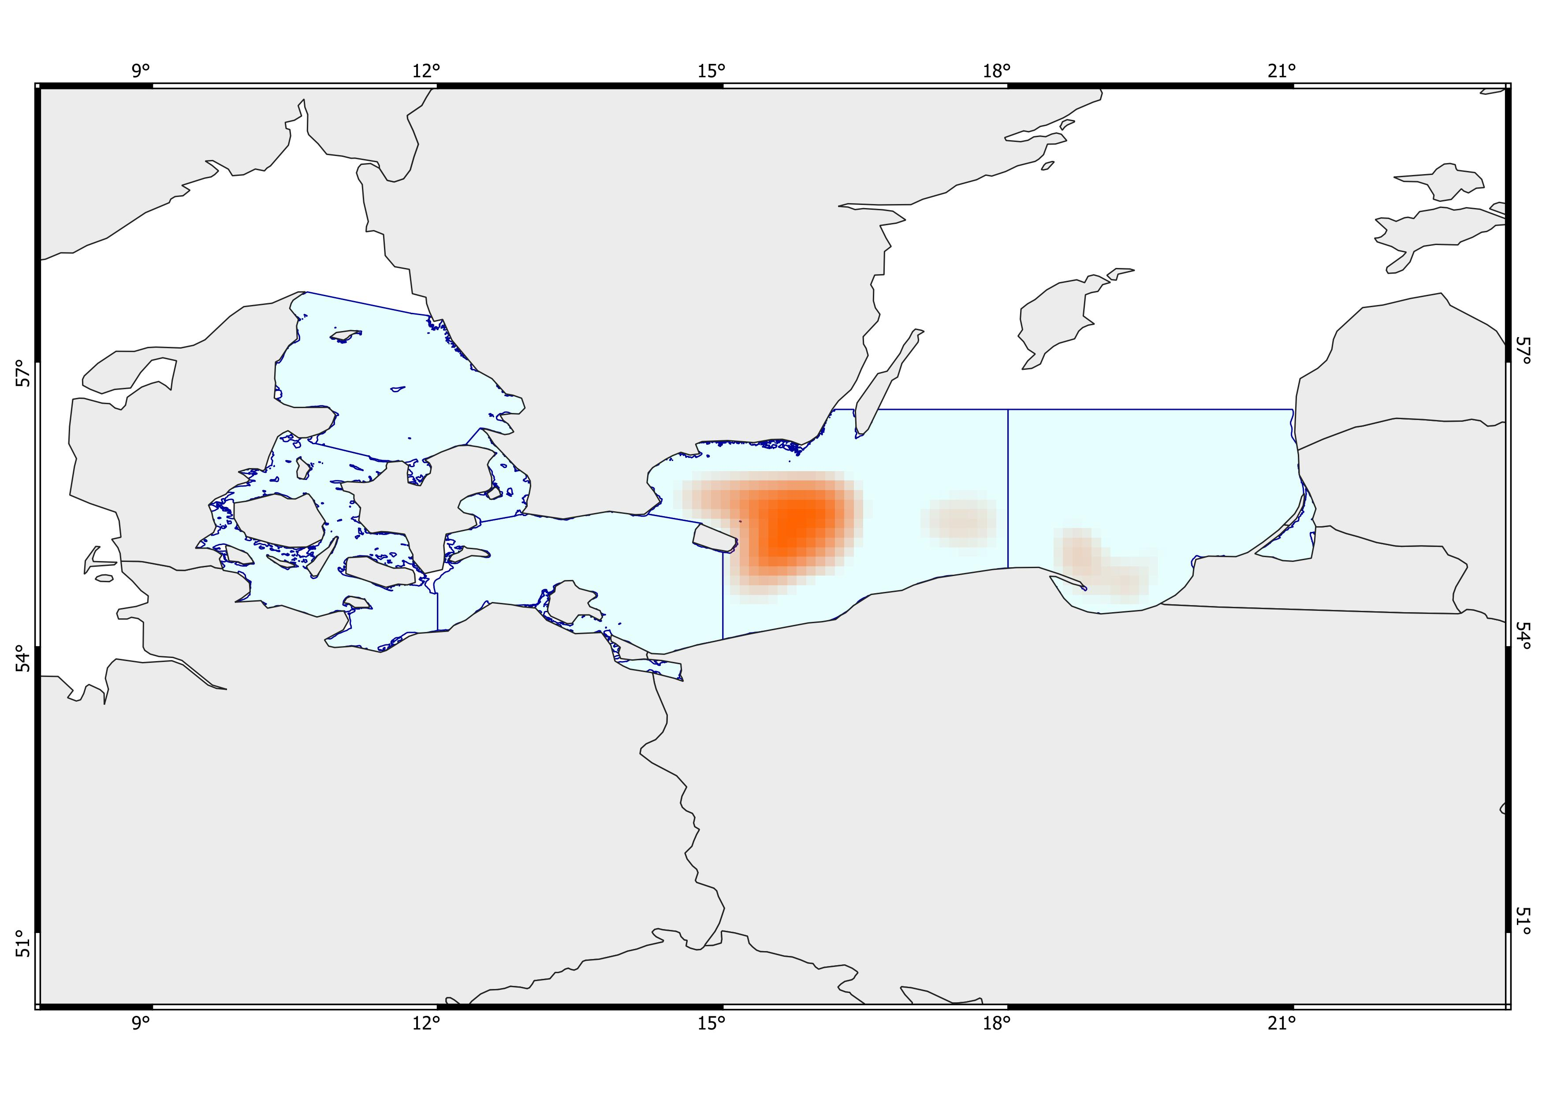
Very deep, cold areas with extremely low bottom oxygen and fair to moderate surface productivity. Very high biomass of five commercial demersal species, high salinity, high fishing activity, and moderate to high shipping traffic. Strong anthropogenic influence with a dominant presence of dumping sites and military areas and minor presence of wind farms.
Deep, cold areas with low bottom oxygen and moderately high surface productivity. Very high biomass of five commercial demersal species, very high fishing activity, moderate shipping traffic, and fair to moderate salinity.
Very deep, cold areas with extremely low bottom oxygen and high surface productivity. Moderate to very high biomass of five commercial demersal species, extremely high fishing activity, high shipping traffic, and moderate salinity. Presence of military areas.
1
2
3
Ecosystem Risk Assessment
Multi K-means
- Five species –
Gadus morhua, Limanda limanda, Merlangius merlangus, Platichthys flesus, Pleuronectes platessa
Ecosystem Risk Assessment
Multi K-means
- Five species –
Gadus morhua, Limanda limanda, Merlangius merlangus, Platichthys flesus, Pleuronectes platessa

Slide 3
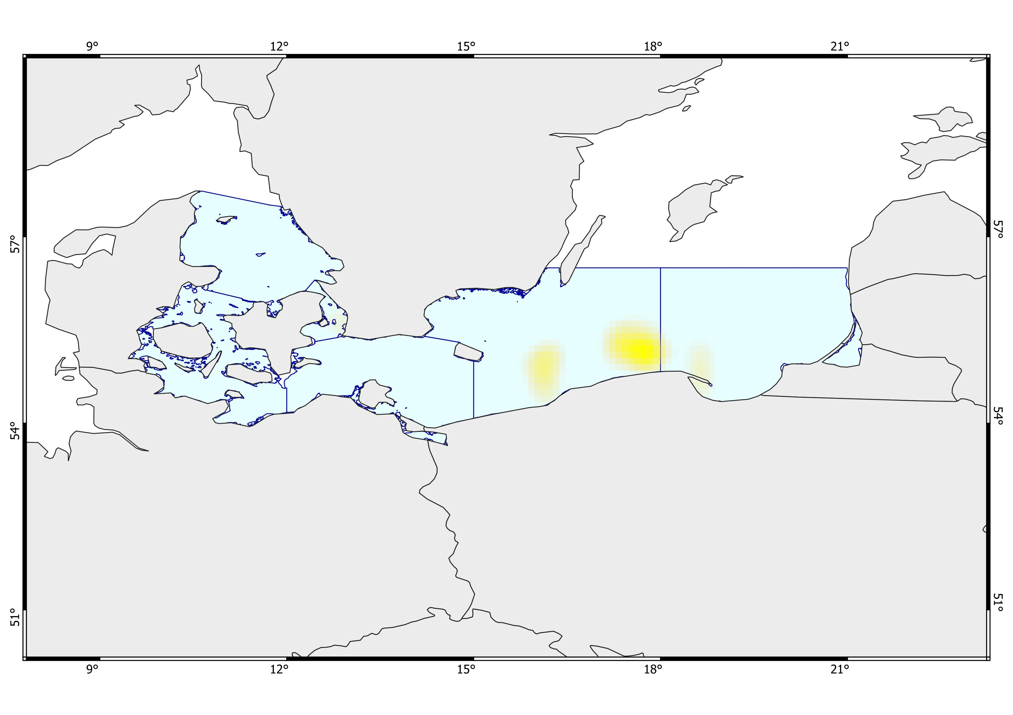
Shallow, warm areas with slightly low bottom oxygen and very high surface productivity. Moderate to high biomass of Gadus morhua, moderately high fishing activity, moderate shipping traffic, and moderate salinity. Minor anthropogenic influence with light presence of dumping sites, military areas, and wind farms.
Fairly deep, cool areas with moderately low bottom oxygen and moderate surface productivity. High biomass of Gadus morhua, moderately high fishing activity, moderate shipping traffic, and fair salinity. Minimal anthropogenic influence, with only light presence of dumping sites, military areas, and wind farms. Partly hardrock seafloor.
Moderately deep to deep, cold areas with high surface productivity, moderately high salinity, and moderate to high bottom oxygen depletion. High biomass of Gadus morhua, moderate fishing activity, and moderate shipping traffic. Minimal anthropogenic influence with limited presence of wind farms and minimal hard-bottom seafloor.
Deep areas with cold bottom temperatures, very high surface productivity, and severe bottom oxygen depletion. High biomass of Gadus morhua, fair to moderate salinity, intense fishing activity, and high shipping traffic. Minimal anthropogenic influence with the presence of military areas and only minimal hard-bottom seafloor.
1
3
2
4
Ecosystem Risk Assessment
Multi K-means
- Gadus morhua -

Slide 4
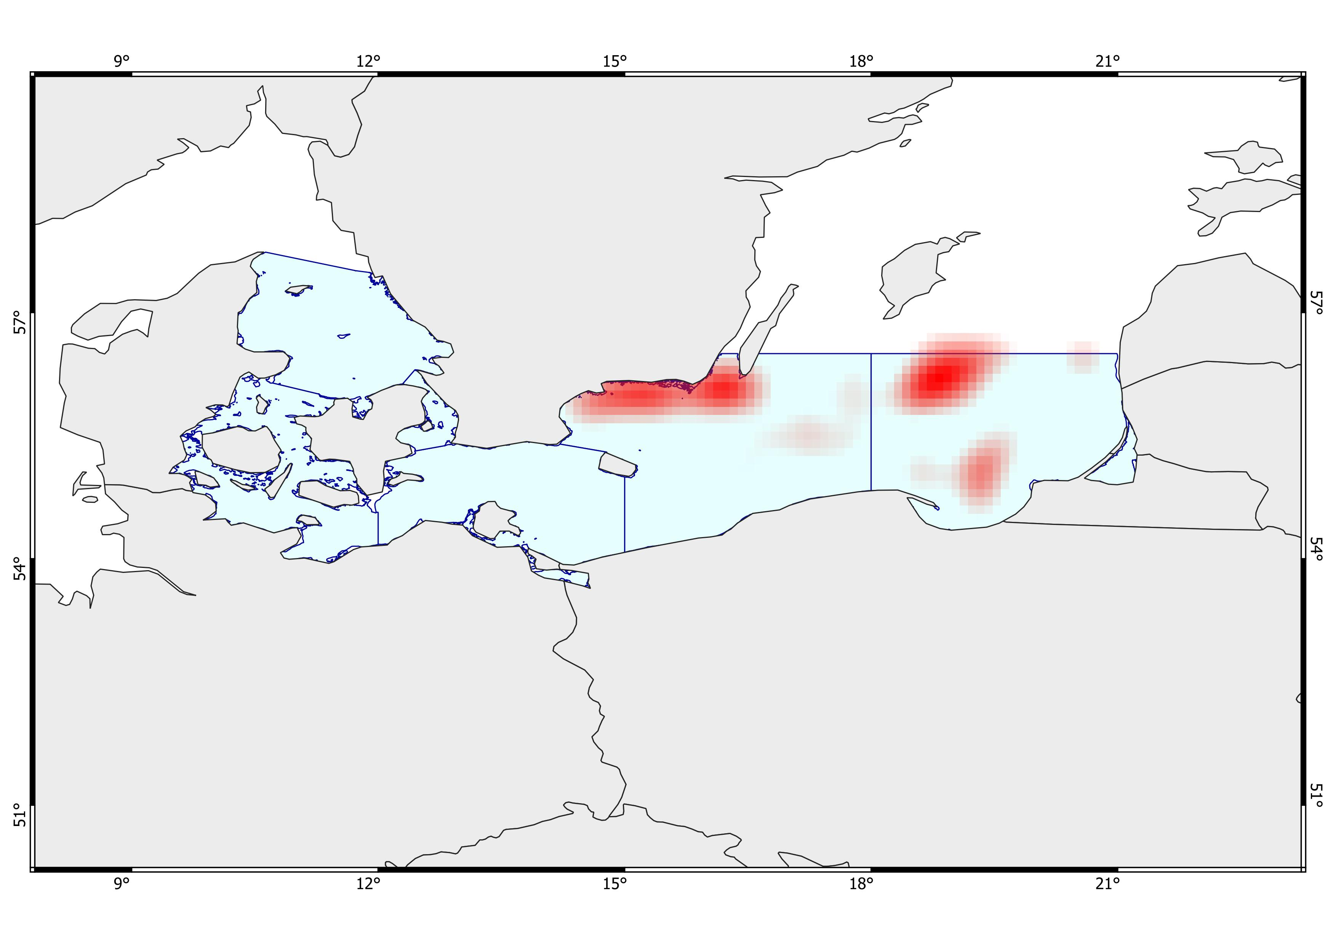
Shallow to moderately deep, moderately cold areas. Fair to moderate surface productivity, high bottom oxygen, and low salinity. Very high biomass. Moderate fishing activity and fair shipping traffic. Strong presence of military areas.
Shallow to deep, cold areas. Low to fair surface productivity, moderate bottom oxygen depletion, and low salinity. Very high biomass. Moderate fishing activity and fair shipping traffic. Strong presence of military areas.
Fairly deep, moderately cold areas. Moderate to high surface productivity, high bottom oxygen, and low salinity. High biomass. Intense fishing activity and moderate to high shipping traffic. Presence of military areas and wind farms.
Very deep and very cold areas. Very high biomass. Very low surface productivity, extremely low bottom oxygen, and moderate salinity. Low fishing activity and moderate to high shipping traffic. Presence of dumping sites.
Shallow waters, moderately cold. Moderate biomass. High surface productivity, high bottom oxygen, and low salinity. Low fishing activity and intense shipping traffic. Presence of military areas.
Very deep, cold areas. Fair to moderate biomass. Moderate to high surface productivity, extremely low bottom oxygen, and moderate salinity. Intense fishing activity and moderate to high shipping traffic.
5
2
4
1
3
6
Ecosystem Risk Assessment
VAE (+ Multi K-means)
- All species -

Slide 5
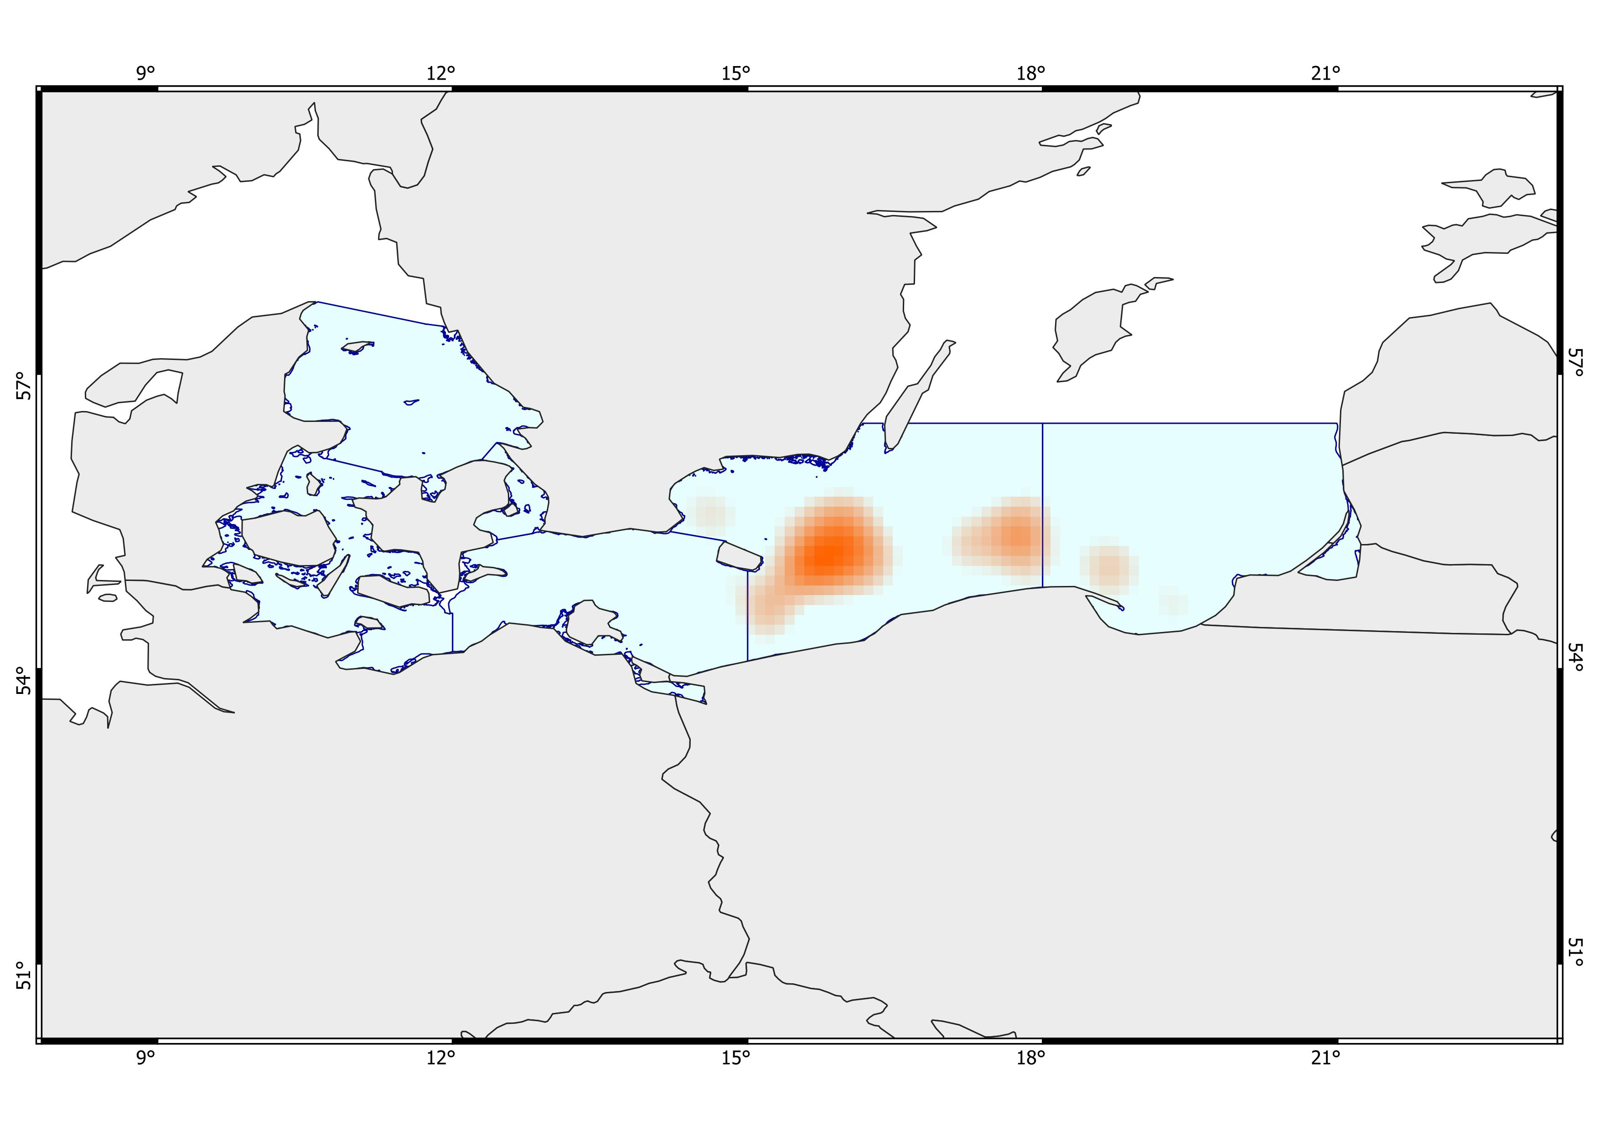
Moderately deep waters, moderately cold. Very high biomass. Moderate surface productivity, moderate depletion of bottom oxygen, and moderate to high bottom salinity. Intense fishing activity and fair shipping traffic. Presence of military areas.
Very deep, cold areas. Very high biomass. Moderate surface productivity, very low bottom oxygen, and high salinity. Intense fishing activity and moderate shipping traffic. Strong presence of dumping sites and military areas. Minimal presence of wind farms.
Moderate to deep, cold areas. Very high biomass. High surface productivity, moderate depletion of bottom oxygen, and moderate to high salinity. Intense fishing activity and moderate shipping traffic. Presence of wind farms. Partial presence of hard bottom.
Very deep, cold areas. Very high biomass. High surface productivity, extremely low bottom oxygen, and moderate salinity. Intense fishing activity, moderate to high shipping traffic. Presence of military areas.
1
2
3
4
Ecosystem Risk Assessment
VAE (+ Multi K-means)
- Five species –
Gadus morhua, Limanda limanda, Merlangius merlangus, Platichthys flesus, Pleuronectes platessa

Slide 6
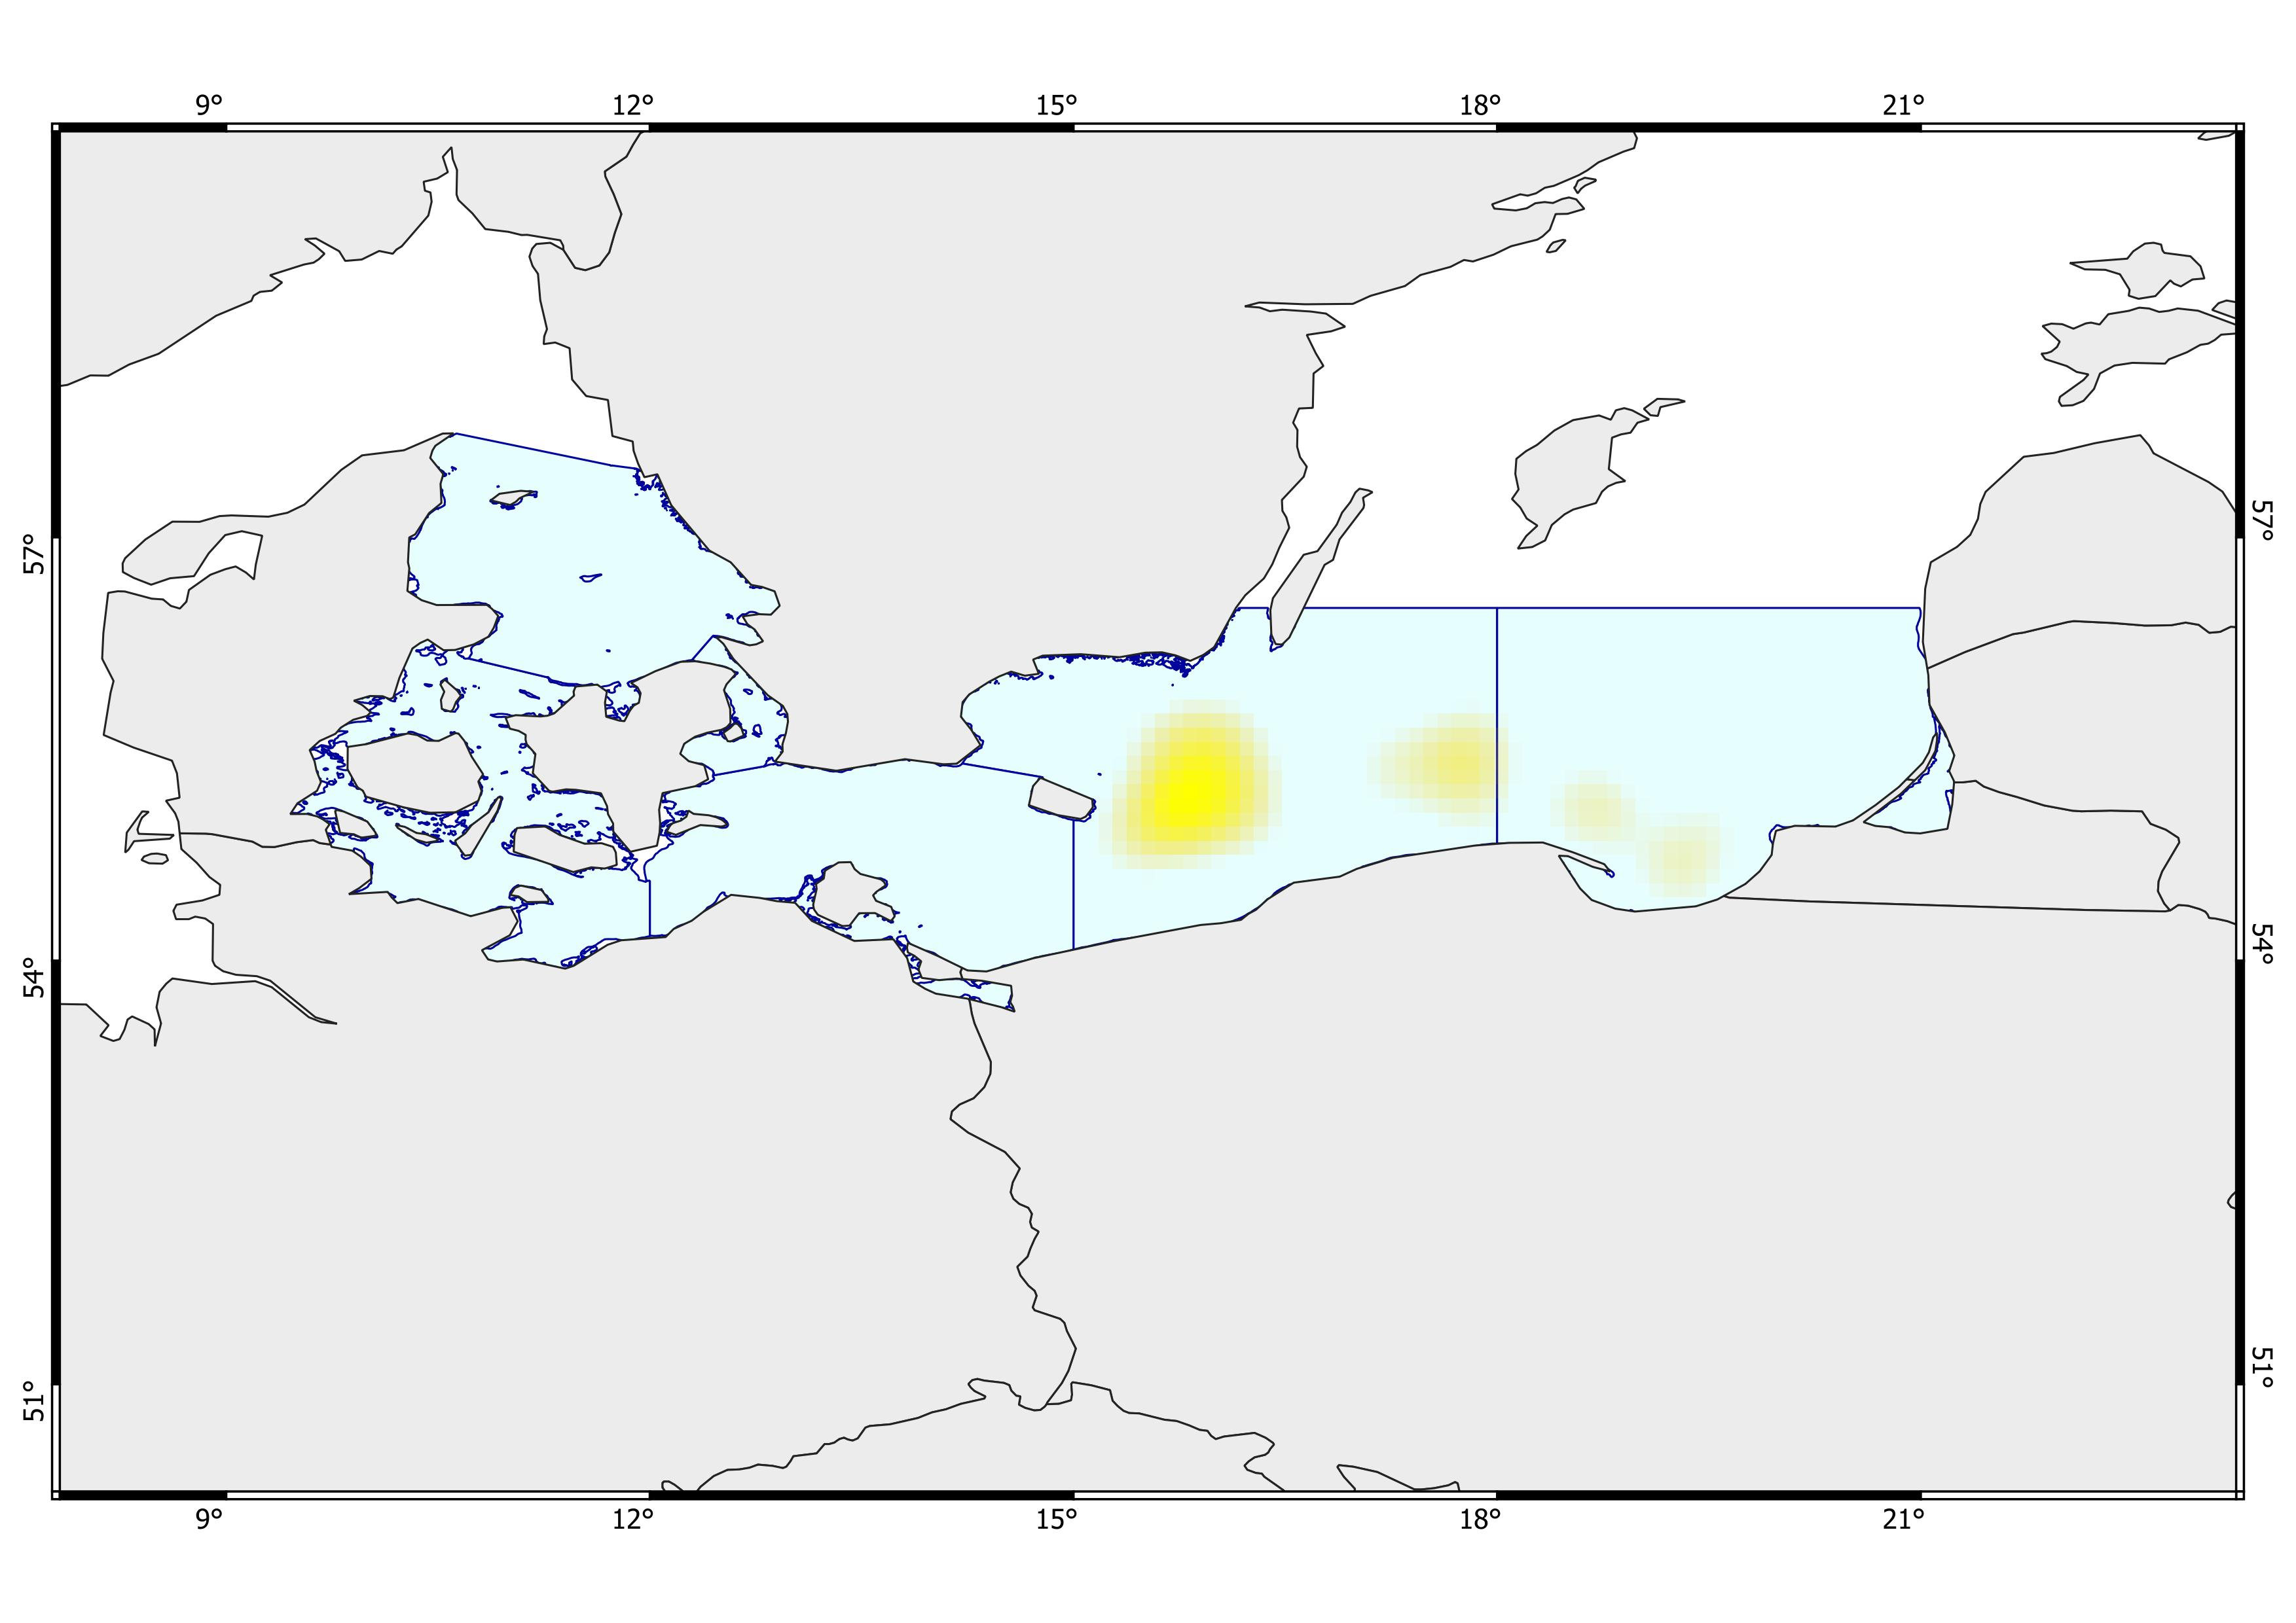
Very deep, cold areas. Very high biomass of Gadus morhua. Moderate surface productivity, very low bottom oxygen, and high salinity. Intense fishing activity and moderate shipping traffic. Strong presence of dumping sites and military areas. Minimal presence of wind farms.
Moderate to deep, cold areas. Very high biomass of Gadus morhua. High surface productivity, moderate depletion of bottom oxygen, and moderate to high salinity. Intense fishing activity and moderate shipping traffic. Presence of wind farms. Partial presence of hard bottom.
Very deep, cold areas. Very high biomass of Gadus morhua. High surface productivity, extremely low bottom oxygen, and moderate salinity. Intense fishing activity, moderate to high shipping traffic. Presence of military areas.
Deep, cold areas with very low bottom oxygen, moderate salinity, and high surface productivity. High biomass of Gadus morhua. Intense fishing activity, and fair shipping traffic. Strong anthropogenic influence with a marked presence of military areas.
1
2
3
4
Ecosystem Risk Assessment
VAE (+ Multi K-means)
- Gadus morhua -

Slide 7
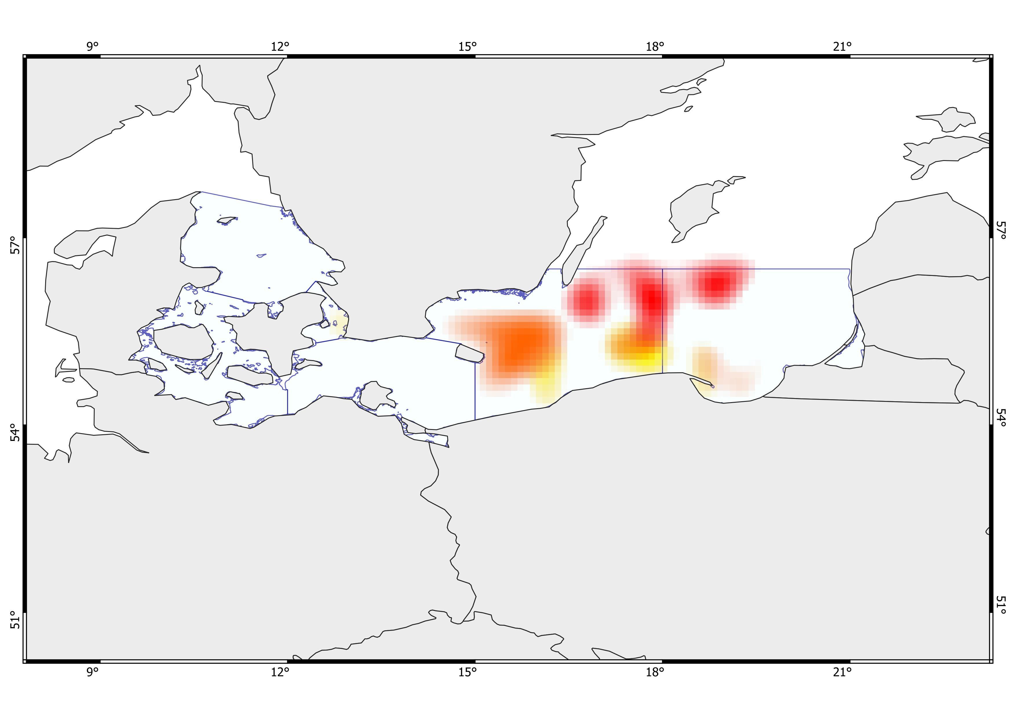
A.mkm Shallow, warm areas with moderate bottom oxygen, very high salinity, and very high surface productivity. High biomass across the general biodiversity, including Gadus morhua. Moderate fishing activity and moderate to high shipping traffic. Minor anthropogenic influence with minimal presence of wind farms, dumping sites, and military areas. Limited bedrock seabed.
B.mkm Very deep areas that become shallower toward the southern coast, moderately cold areas, moderate surface productivity, and extremely low bottom oxygen in the central zone, with less severe depletion near the Southern coast. Moderately high salinity. Biomass is generally moderate, high for the five commercially important species, including Gadus morhua. High to very high fishing activity, and shipping traffic from moderate to fairly high. Strong anthropogenic influence with a marked presence of dumping sites and military areas. Limited hard-rock seabed.
C.mkm Relatively shallow, very cold areas with moderately low bottom oxygen and very low bottom salinity, and low surface productivity. Biomass is generally very high, while the five commercially important species range from moderate to high. Fair fishing activity and moderate shipping traffic. Moderate to high anthropogenic influence, with dumping sites and wind farms.
D.mkm Very deep, very cold areas with extremely low bottom oxygen, low bottom salinity, and quite low surface productivity. Overall biomass is high, biomass of the five commercially important species is moderate, and Gadus morhua biomass is high. Fishing activity ranges from fair to moderate, and shipping traffic is fair. Minor anthropogenic influence with the presence of wind farms.
E.mkm Deep, cold areas with very low bottom oxygen, moderate to high salinity, and low surface productivity. Overall biomass is very high, while biomass of the five commercially important species and Gadus morhua is low. Fishing activity is low to fair, and shipping traffic is moderate. Strong anthropogenic influence with a marked presence of dumping sites and very few wind farms.
D.mkm
E.mkm
A.mkm
C.mkm
B.mkm
F.mkm
G.mkm
H.mkm
Ecosystem Risk Assessment
Multi K-means
- Ensamble -
1

Slide 8
F.mkm Moderately deep to deep, cold areas with moderately low bottom oxygen and fair to high salinity, and moderate to high surface productivity. Overall biomass is high, with high biomass of the five commercially important species and Gadus morhua. Moderate fishing activity, and fair to moderate shipping traffic. Minor anthropogenic influence with the presence of wind farms. Partly hardbottom seafloor.
G.mkm Deep, cold areas with moderate to high bottom oxygen depletion and fair to moderate salinity, and high surface productivity. Overall biomass is high, with high biomass of the five commercially important species and Gadus morhua. Fishing activity is high, and shipping traffic ranges from moderate to high. Strong anthropogenic influence with a marked presence of military areas. Minimal hard-bottom seafloor.
H.mkm Deep, cold areas with very low bottom oxygen, moderate salinity, and high surface productivity. Overall biomass is very high, biomass of the five commercially important species is moderate, and Gadus morhua biomass is high. Fishing activity is very intense, and shipping traffic is fair. Strong anthropogenic influence with a marked presence of military areas.
D.mkm
E.mkm
A.mkm
C.mkm
B.mkm
F.mkm
G.mkm
H.mkm
Ecosystem Risk Assessment
Multi K-means
- Ensamble -
2

Slide 9
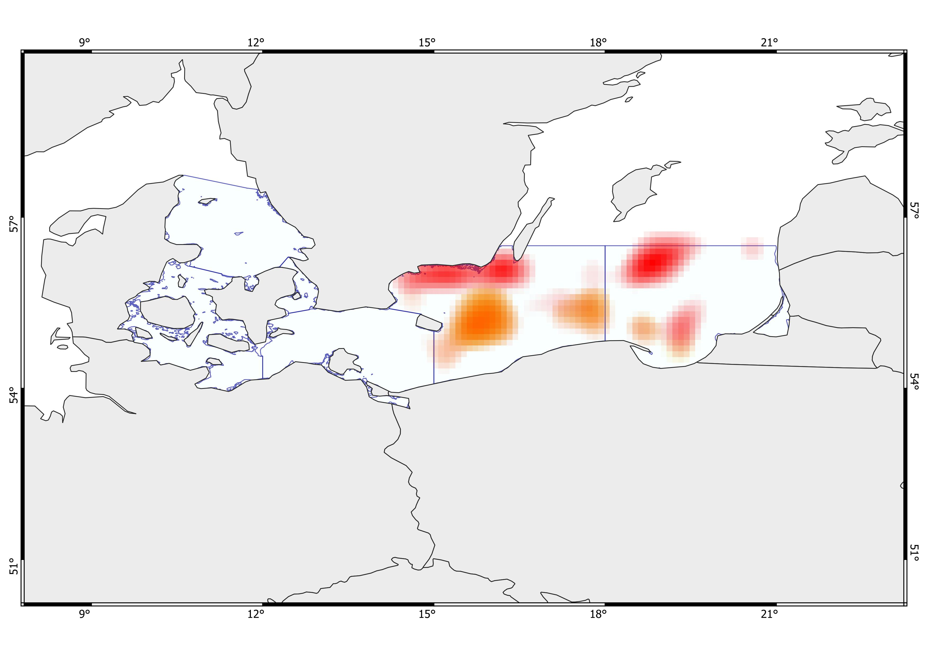
A.vae Moderately deep areas with cool to moderately cold bottom temperatures, low bottom salinity, and fair to moderate surface productivity. High bottom oxygen levels. Very high overall biomass, with high biomass of the five commercially important species. Moderate to high fishing activity and fair to moderate shipping traffic. Strong anthropogenic influence, with a marked presence of military areas. Partly hard-rock seafloor.
B.vae Moderately deep areas with cold bottom temperatures, low salinity, and low to fairly moderate surface productivity. High bottom oxygen levels. Very high overall biomass, low biomass of the five commercially important species, and moderate biomass of Gadus morhua. Fishing activity ranges from fair to high, and shipping traffic from fair to high. Strong anthropogenic influence with a marked presence of military areas. Presence of hard-bottom seafloor.
C.vae Deep, cold areas with very low bottom oxygen, moderate to high salinity, and low surface productivity. Overall biomass is very high, while biomass of the five commercially important species and Gadus morhua is low. Fishing activity is low to fair, and shipping traffic is moderate. Strong anthropogenic influence with a marked presence of dumping sites and very few wind farms.
D.vae Shallow areas with moderately cold temperatures, moderate to high surface productivity, low salinity, and very high bottom oxygen levels. Overall biomass ranges from moderate to high, with moderate biomass of the five commercially important species, including Gadus morhua. Fishing activity is low, while shipping traffic is very intense. Strong anthropogenic influence with a marked presence of military areas. Partly hard-bottom seafloor.
D.vae
B.vae
C.vae
A.vae
E.vae
F.vae
G.vae
H.vae
Ecosystem Risk Assessment
VAE (+ Multi K-means)
- Ensamble -
1

Slide 10
E.vae Very deep areas that become shallower toward the southern coast, moderately cold areas, moderate surface productivity, and extremely low bottom oxygen in the central zone, with less severe depletion near the Southern coast. Moderately high salinity. Biomass is generally moderate, high for the five commercially important species, including Gadus morhua. High to very high fishing activity, and shipping traffic from moderate to fairly high. Strong anthropogenic influence with a marked presence of dumping sites and military areas. Limited hard-rock seabed.
F.vae Moderately deep to deep, cold areas with moderately low bottom oxygen and fair to high salinity, and moderate to high surface productivity. Overall biomass is high, with high biomass of the five commercially important species and Gadus morhua. Moderate fishing activity, and fair to moderate shipping traffic. Minor anthropogenic influence with the presence of wind farms. Partly hardbottom seafloor.
G.vae Deep, cold areas with moderate to high bottom oxygen depletion and fair to moderate salinity, and high surface productivity. Overall biomass is high, with high biomass of the five commercially important species and Gadus morhua. Fishing activity is high, and shipping traffic ranges from moderate to high. Strong anthropogenic influence with a marked presence of military areas. Minimal hard-bottom seafloor.
H.vae Very deep, cold areas with extremely low bottom oxygen, moderate salinity, and moderate to high surface productivity. Overall biomass is fairly moderate, with fair to low biomass of the five commercially important species and moderate biomass of Gadus morhua. Fishing activity is intense, and shipping traffic is high.
D.vae
B.vae
C.vae
A.vae
E.vae
F.vae
G.vae
H.vae
Ecosystem Risk Assessment
VAE (+ Multi K-means)
- Ensamble -
2

Slide 11
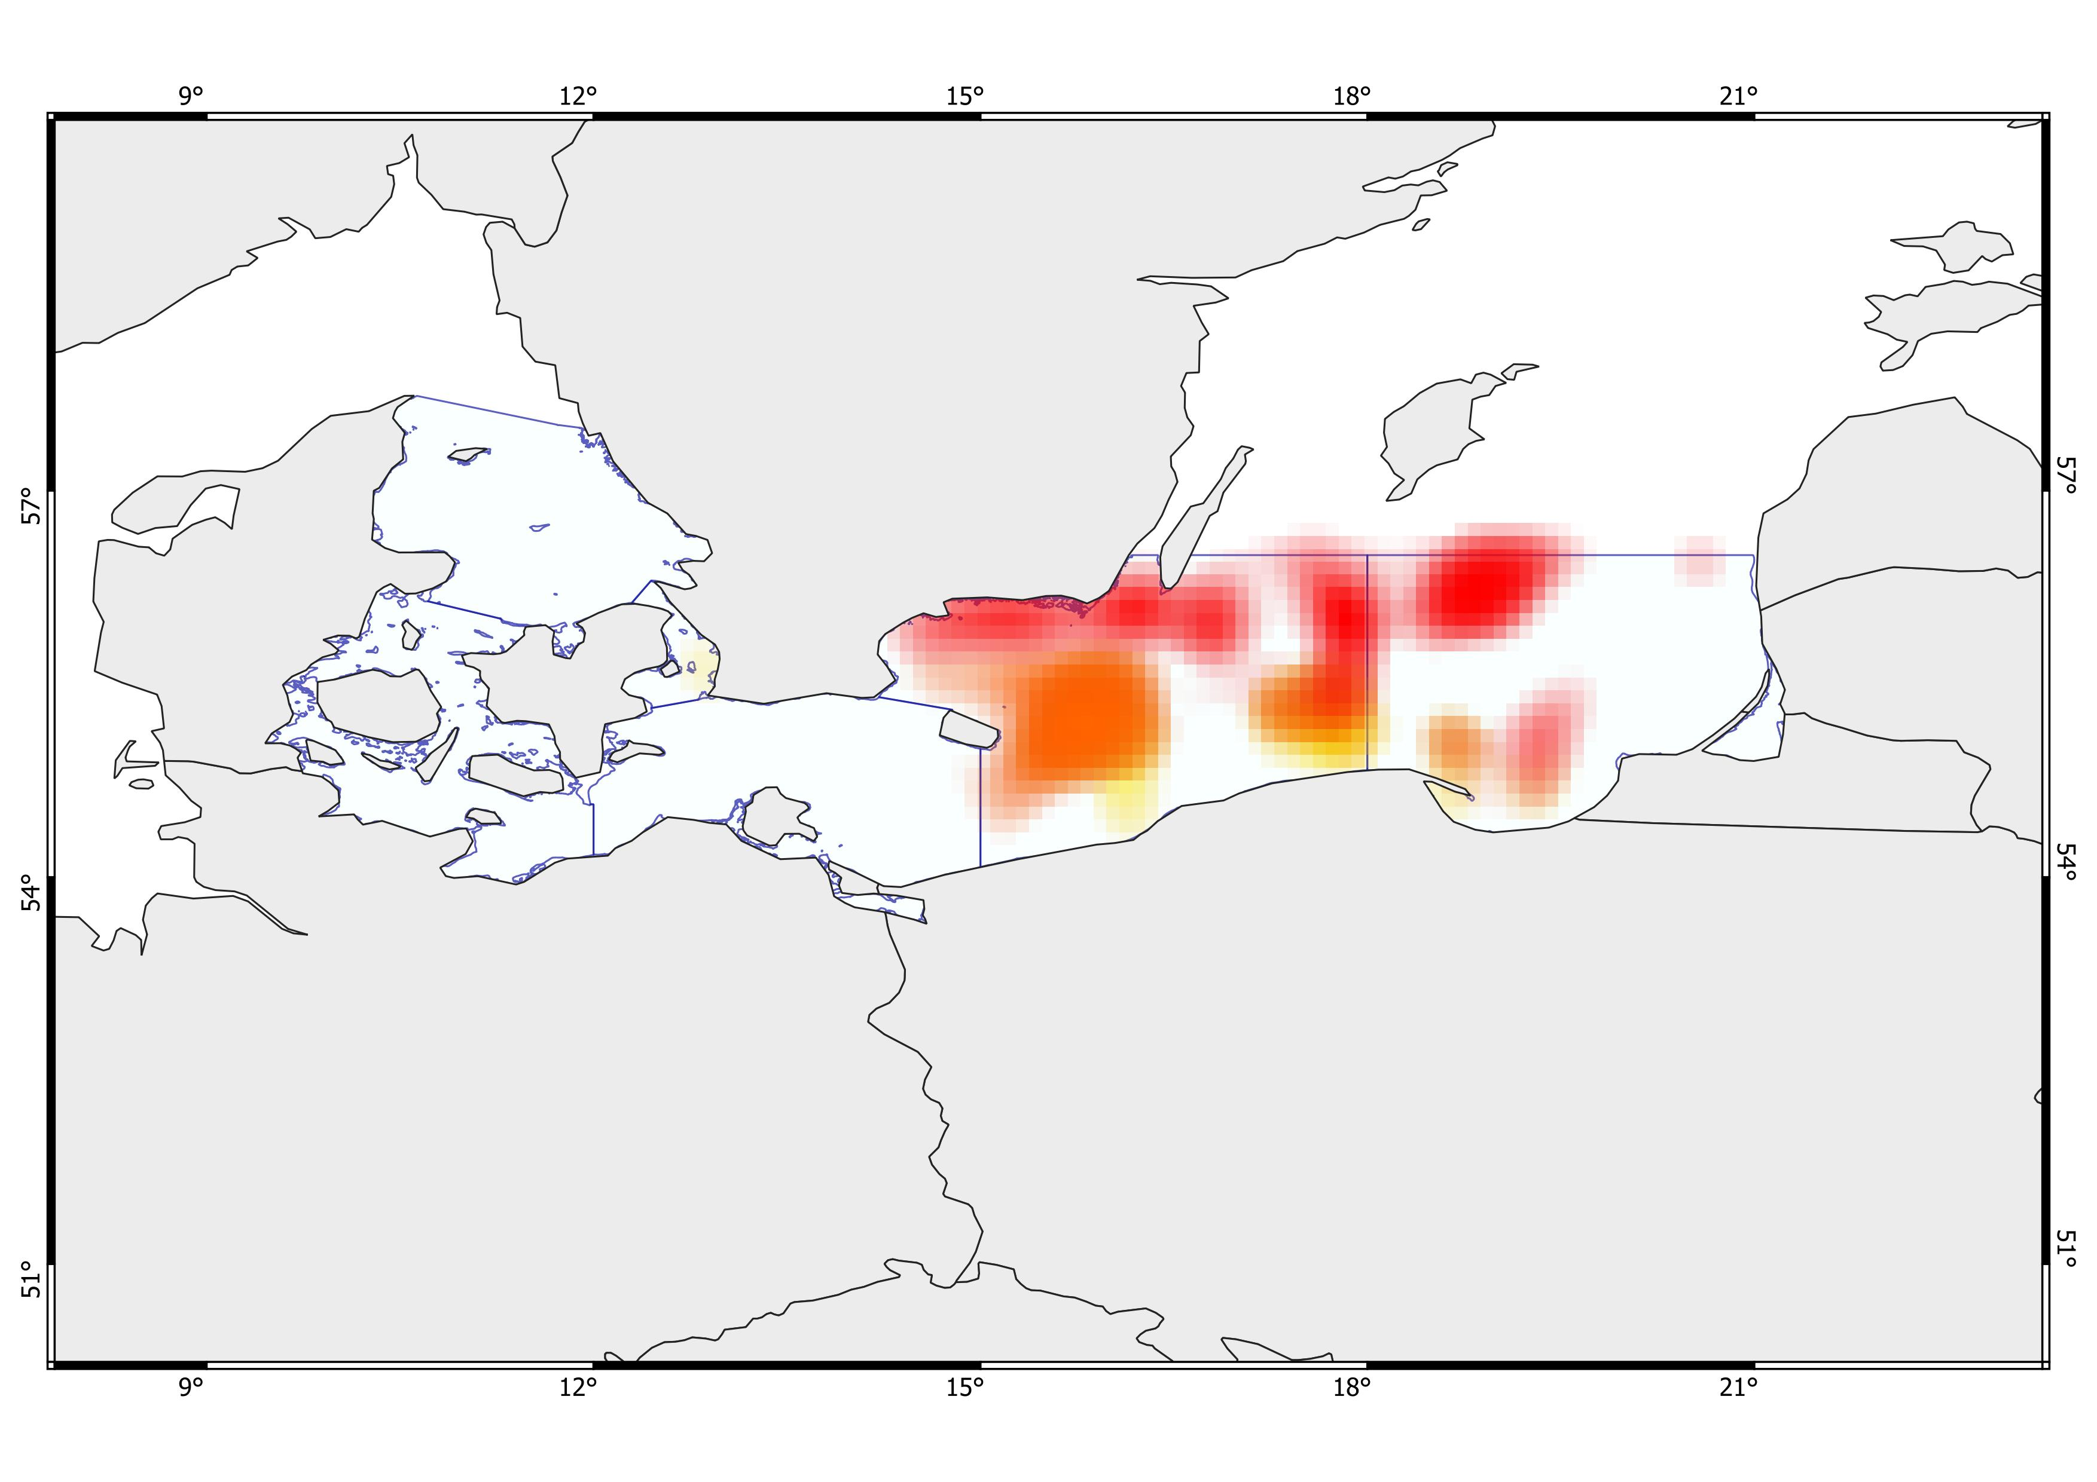
A. Shallow, warm areas with moderate bottom oxygen, very high salinity, and very high surface productivity. High biomass across the general biodiversity, including Gadus morhua. Moderate fishing activity and moderate to high shipping traffic. Minor anthropogenic influence with minimal presence of wind farms, dumping sites, and military areas. Limited bedrock seabed.
B. Moderately deep areas with cool to moderately cold bottom temperatures, low bottom salinity, and fair to moderate surface productivity. High bottom oxygen levels. Very high overall biomass, with high biomass of the five commercially important species. Moderate to high fishing activity and fair to moderate shipping traffic. Strong anthropogenic influence, with a marked presence of military areas. Partly hard-rock seafloor.
C. Moderately deep areas with cold bottom temperatures, low salinity, and low to fairly moderate surface productivity. High bottom oxygen levels. Very high overall biomass, low biomass of the five commercially important species, and moderate biomass of Gadus morhua. Fishing activity ranges from fair to high, and shipping traffic from fair to high. Strong anthropogenic influence with a marked presence of military areas. Presence of hard-bottom seafloor.
D. Relatively shallow, very cold areas with moderately low bottom oxygen and very low bottom salinity, and low surface productivity. Biomass is generally very high, while the five commercially important species range from moderate to high. Fair fishing activity and moderate shipping traffic. Moderate to high anthropogenic influence, with dumping sites and wind farms.
E. Very deep, very cold areas with extremely low bottom oxygen, low bottom salinity, and quite low surface productivity. Overall biomass is high, biomass of the five commercially important species is moderate, and Gadus morhua biomass is high. Fishing activity ranges from fair to moderate, and shipping traffic is fair. Minor anthropogenic influence with the presence of wind farms.
A Shallow, warm areas with moderate bottom oxygen, very high salinity, and very high surface productivity. High biomass across the general biodiversity, including Gadus morhua. Moderate fishing activity and moderate to high shipping traffic. Minor anthropogenic influence with minimal presence of wind farms, dumping sites, and military areas. Limited bedrock seabed.
(P) Very deep areas that become shallower toward the southern coast, moderately cold areas, moderate surface productivity, and extremely low bottom oxygen in the central zone, with less severe depletion near the Southern coast. Moderately high salinity. Biomass is generally moderate, high for the five commercially important species, including Gadus morhua. High to very high fishing activity, and shipping traffic from moderate to fairly high. Strong anthropogenic influence with a marked presence of dumping sites and military areas. Limited hard-rock seabed.
Relatively shallow, very cold areas with moderately low bottom oxygen and very low bottom salinity, and low surface productivity. Biomass is generally very high, while the five commercially important species range from moderate to high. Fair fishing activity and moderate shipping traffic. Moderate to high anthropogenic influence, with dumping sites and wind farms.
Very deep, very cold areas with extremely low bottom oxygen, low bottom salinity, and quite low surface productivity. Overall biomass is high, biomass of the five commercially important species is moderate, and Gadus morhua biomass is high. Fishing activity ranges from fair to moderate, and shipping traffic is fair. Minor anthropogenic influence with the presence of wind farms.
(N) Deep, cold areas with very low bottom oxygen, moderate to high salinity, and low surface productivity. Overall biomass is very high, while biomass of the five commercially important species and Gadus morhua is low. Fishing activity is low to fair, and shipping traffic is moderate. Strong anthropogenic influence with a marked presence of dumping sites and very few wind farms.
(Q) Moderately deep to deep, cold areas with moderately low bottom oxygen and fair to high salinity, and moderate to high surface productivity. Overall biomass is high, with high biomass of the five commercially important species and Gadus morhua. Moderate fishing activity, and fair to moderate shipping traffic. Minor anthropogenic influence with the presence of wind farms. Partly hardbottom seafloor.
(R) Deep, cold areas with moderate to high bottom oxygen depletion and fair to moderate salinity, and high surface productivity. Overall biomass is high, with high biomass of the five commercially important species and Gadus morhua. Fishing activity is high, and shipping traffic ranges from moderate to high. Strong anthropogenic influence with a marked presence of military areas. Minimal hard-bottom seafloor.
(+S) Deep areas with cold bottom temperatures, moderate salinity, and moderate to very high surface productivity. Extremely low bottom oxygen. Overall biomass ranges from moderate to very high, with fair to moderate biomass of the five commercial species and moderate to moderately high biomass of Gadus morhua. Intense fishing activity, moderate to high shipping traffic.Minor anthropogenic influence with limited presence of military areas.
G
c
D
E
F
A
B
H
I
L
M
Shallow areas with moderately cold temperatures, moderate to high surface productivity, low salinity, and very high bottom oxygen levels. Overall biomass ranges from moderate to high, with moderate biomass of the five commercially important species, including Gadus morhua. Fishing activity is low, while shipping traffic is very intense. Strong anthropogenic influence with a marked presence of military areas. Partly hard-bottom seafloor.
Ecosystem Risk Assessment
Multi K-means
&
VAE (+ Multi K-means)
- Ensamble -
(+H) Deep areas with cold bottom temperatures, moderate salinity, and moderate to very high surface productivity. Extremely low bottom oxygen. Overall biomass ranges from moderate to very high, with fair to moderate biomass of the five commercial species and moderate to moderately high biomass of Gadus morhua. Intense fishing activity, moderate to high shipping traffic. Minor anthropogenic influence with limited presence of military areas.
Moderately deep areas with cool to moderately cold bottom temperatures, low bottom salinity, and fair to moderate surface productivity. High bottom oxygen levels. Very high overall biomass, with high biomass of the five commercially important species. Moderate to high fishing activity and fair to moderate shipping traffic. Strong anthropogenic influence, with a marked presence of military areas. Partly hard-rock seafloor.
Moderately deep areas with cold bottom temperatures, low salinity, and low to fairly moderate surface productivity. High bottom oxygen levels. Very high overall biomass, low biomass of the five commercially important species, and moderate biomass of Gadus morhua. Fishing activity ranges from fair to high, and shipping traffic from fair to high. Strong anthropogenic influence with a marked presence of military areas. Presence of hard-bottom seafloor.
1

Slide 12
(Q) Moderately deep to deep, cold areas with moderately low bottom oxygen and fair to high salinity, and moderate to high surface productivity. Overall biomass is high, with high biomass of the five commercially important species and Gadus morhua. Moderate fishing activity, and fair to moderate shipping traffic. Minor anthropogenic influence with the presence of wind farms. Partly hardbottom seafloor.
(R) Deep, cold areas with moderate to high bottom oxygen depletion and fair to moderate salinity, and high surface productivity. Overall biomass is high, with high biomass of the five commercially important species and Gadus morhua. Fishing activity is high, and shipping traffic ranges from moderate to high. Strong anthropogenic influence with a marked presence of military areas. Minimal hard-bottom seafloor.
(+S) Deep areas with cold bottom temperatures, moderate salinity, and moderate to very high surface productivity. Extremely low bottom oxygen. Overall biomass ranges from moderate to very high, with fair to moderate biomass of the five commercial species and moderate to moderately high biomass of Gadus morhua. Intense fishing activity, moderate to high shipping traffic.Minor anthropogenic influence with limited presence of military areas.
F. Deep, cold areas with very low bottom oxygen, moderate to high salinity, and low surface productivity. Overall biomass is very high, while biomass of the five commercially important species and Gadus morhua is low. Fishing activity is low to fair, and shipping traffic is moderate. Strong anthropogenic influence with a marked presence of dumping sites and very few wind farms. (.mkm) (.vae)
G. Shallow areas with moderately cold temperatures, moderate to high surface productivity, low salinity, and very high bottom oxygen levels. Overall biomass ranges from moderate to high, with moderate biomass of the five commercially important species, including Gadus morhua. Fishing activity is low, while shipping traffic is very intense. Strong anthropogenic influence with a marked presence of military areas. Partly hard-bottom seafloor.
H. Very deep areas that become shallower toward the southern coast, moderately cold areas, moderate surface productivity, and extremely low bottom oxygen in the central zone, with less severe depletion near the Southern coast. Moderately high salinity. Biomass is generally moderate, high for the five commercially important species, including Gadus morhua. High to very high fishing activity, and shipping traffic from moderate to fairly high. Strong anthropogenic influence with a marked presence of dumping sites and military areas. Limited hard-rock seabed.
I. Moderately deep to deep, cold areas with moderately low bottom oxygen and fair to high salinity, and moderate to high surface productivity. Overall biomass is high, with high biomass of the five commercially important species and Gadus morhua. Moderate fishing activity, and fair to moderate shipping traffic. Minor anthropogenic influence with the presence of wind farms. Partly hardbottom seafloor.
E
O
L
M
C
D
N
A
B
Q
P
F
R
G
S
H
Moderately deep areas with cool to moderately cold bottom temperatures, low bottom salinity, and fair to moderate surface productivity. High bottom oxygen levels. Very high overall biomass, with high biomass of the five commercially important species. Moderate to high fishing activity and fair to moderate shipping traffic. Strong anthropogenic influence, with a marked presence of military areas. Partly hard-rock seafloor.
Moderately deep areas with cold bottom temperatures, low salinity, and low to fairly moderate surface productivity. High bottom oxygen levels. Very high overall biomass, low biomass of the five commercially important species, and moderate biomass of Gadus morhua. Fishing activity ranges from fair to high, and shipping traffic from fair to high. Strong anthropogenic influence with a marked presence of military areas. Presence of hard-bottom seafloor.
Ecosystem Risk Assessment
Multi K-means
&
VAE (+ Multi K-means)
- Ensamble -
2

Slide 13
Shallow areas with moderately cold temperatures, moderate to high surface productivity, low salinity, and very high bottom oxygen levels. Overall biomass ranges from moderate to high, with moderate biomass of the five commercially important species, including Gadus morhua. Fishing activity is low, while shipping traffic is very intense. Strong anthropogenic influence with a marked presence of military areas. Partly hard-bottom seafloor.
(+H) Deep areas with cold bottom temperatures, moderate salinity, and moderate to very high surface productivity. Extremely low bottom oxygen. Overall biomass ranges from moderate to very high, with fair to moderate biomass of the five commercial species and moderate to moderately high biomass of Gadus morhua. Intense fishing activity, moderate to high shipping traffic.Minor anthropogenic influence with limited presence of military areas.
L. Deep, cold areas with moderate to high bottom oxygen depletion and fair to moderate salinity, and high surface productivity. Overall biomass is high, with high biomass of the five commercially important species and Gadus morhua. Fishing activity is high, and shipping traffic ranges from moderate to high. Strong anthropogenic influence with a marked presence of military areas. Minimal hard-bottom seafloor.
M. Deep areas with cold bottom temperatures, moderate salinity, and moderate to very high surface productivity. Extremely low bottom oxygen. Overall biomass ranges from moderate to very high, with fair to moderate biomass of the five commercial species and moderate to moderately high biomass of Gadus morhua. Intense fishing activity, moderate to high shipping traffic. Minor anthropogenic influence with limited presence of military areas.
E
O
L
M
C
D
N
A
B
Q
P
F
R
G
S
H
Ecosystem Risk Assessment
Multi K-means
&
VAE (+ Multi K-means)
- Ensamble -
3

Slide 14
Ecosystem Risk Assessment
Multi K-means
- All species -
Ecosystem Risk Assessment
Multi K-means
- Five species –
Gadus morhua, Limanda limanda, Merlangius merlangus, Platichthys flesus, Pleuronectes platessa
Ecosystem Risk Assessment
Multi K-means
- Gadus morhua -
Ecosystem Risk Assessment
VAE (+ Multi K-means)
- All species -
Ecosystem Risk Assessment
VAE (+ Multi K-means)
- Five species –
Gadus morhua, Limanda limanda, Merlangius merlangus, Platichthys flesus, Pleuronectes platessa
Ecosystem Risk Assessment
VAE (+ Multi K-means)
- Gadus morhua -
Ecosystem Risk Assessment
Multi K-means
- Ensamble -
Ecosystem Risk Assessment
VAE (+ Multi K-means)
- Ensamble -
All 145 species (from BITS 2020)
Ecosystem Risk Assessment
Multi K-means & VAE (+ Multi K-means)
- Ensamble -
Five commercial species (from BITS 2020)
Gadus morhua, Limanda limanda, Merlangius merlangus, Platichthys flesus, Pleuronectes platessa
Gadus morhua (from BITS 2020)

